Slide 1
Artificial Intelligence and Building Information Modelling for Sustainable Construction Project Management and Digitalization in Construction
Week of February 23th
Elias Hord

Slide 2
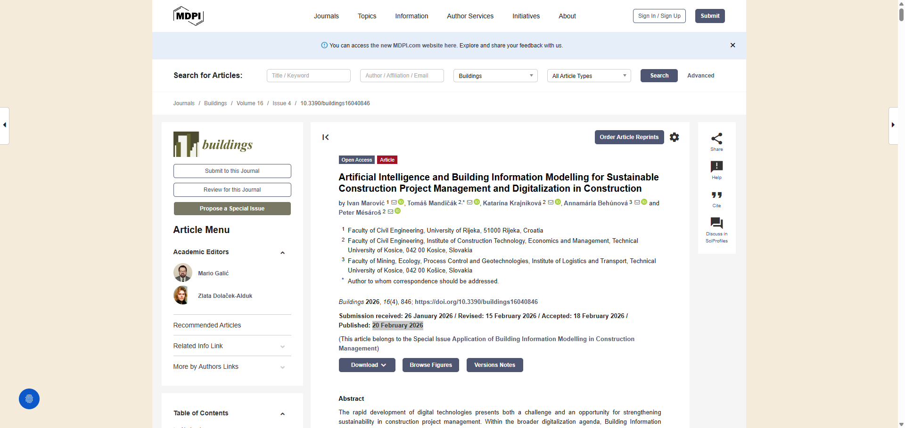
General Information
Article Publication: February 20, 2026
https://www.mdpi.com/2075-5309/16/4/846

Slide 3
Main Findings and Arguments
1.1 Core Argument
The study argues that integrating Building Information Modelling (BIM) and Artificial Intelligence (AI) significantly enhances sustainability-oriented planning in construction—particularly in cost, schedule, and resource optimization. However, their effectiveness depends on organizational readiness and skilled human oversight.
The authors frame BIM and AI as socio-technical systems, meaning their impact is shaped not just by software availability but by:
1.2 Empirical Study Design
The study tested seven hypotheses examining associations between BIM/AI use and sustainability outcomes.
1.3 Key Quantitative Results
Strong Positive Correlations Found
Both BIM and AI show statistically significant positive relationships with sustainability-oriented planning outcomes.
Conclusion: BIM demonstrates stronger associations with sustainability planning than AI.
1.4 Adoption Patterns
This suggests digital tools are primarily used for planning efficiency, not yet for deep material circularity or lifecycle sustainability.
1.5 Complementary Roles of BIM and AI
The study finds maximum effectiveness when:
Digital tools do not replace human decision-makers—they amplify them.

Slide 4
Broader Implications for Society
2.1 Sustainability and Climate Goals
Digital tools like BIM and AI support:
Resource efficiency
Waste reduction
Energy optimization
Improved long-term cost structuring
2.2 Digital Divide Within Europe
This has implications for:
Competitiveness
Cross-border collaboration
Access to EU-funded projects
Supply chain integration
2.3 Workforce Transformation
Automation does not eliminate human roles—it transforms them.
Construction becomes more knowledge-intensive rather than labor-intensive.
2.4 From Tool Adoption to Systemic Change
This reinforces the idea that technology alone does not create transformation—systems do.

Slide 5
Relevance or Potential Influence on the Construction Industry
3.1 Immediate Industry Implications
The research provides strong statistical evidence that:
BIM significantly enhances sustainable cost and resource planning
AI enhances forecasting and optimization but remains underused
Combined BIM–AI deployment yields stronger outcomes
For industry leaders, this strengthens the business case for:
BIM maturity upgrades
AI integration into planning workflows
Investment in digital capability development
3.2 Strategic Insights for Contractors and Developers
Cost optimization is currently the strongest application area. However, the industry is underutilizing digital tools for:
Materials circularity
Lifecycle carbon tracking
Advanced resource efficiency
This signals a future competitive advantage for firms that move beyond planning efficiency toward full lifecycle sustainability modeling.

Slide 6
Relevance or Potential Influence on the Construction Industry
3.3 Implications for SMEs
Since SMEs dominate construction in Central Europe:
High upfront investment remains a barrier
Skill gaps limit adoption
Lack of regulatory mandates slows diffusion
Policy incentives and shared digital infrastructure could accelerate uptake.
3.4 Industry 4.0 Transition
The findings support the broader shift toward Construction 4.0:
BIM → Structured digital backbone
AI → Intelligent analytics layer
Digital twins → Future integration pathway
This evolution could lead to:
Real-time performance monitoring
Predictive maintenance
Automated compliance checking
Generative sustainable design

Slide 7
Relevance or Potential Influence on the Construction Industry
3.5 Long-Term Competitive Impact
Firms that successfully integrate BIM and AI will likely achieve:
Lower cost overruns
Better schedule reliability
Improved sustainability metrics
Higher project transparency
Those that do not risk falling behind in increasingly digital procurement ecosystems.

